Slide 1



Comparison between stigmergy and gossip algorithms in an agent network
Ionut Cotoi
Polytechnic University of Bucharest
Complex Systems Master Programme - 2020
Introduction in Complex Systems

Slide 2
Gossip
Procedure or process of peer-to-peer comunication modeled on the way epidemics spread
In our case, 2 agents will have to “meet” in order to “gossip”

Slide 3
Stigmergy
From insect collonies (ants) that leave information in the environment
In our case, a shared-memory approach is used as the evironment, the agents “leave” information written on the cell they occupied

Slide 4
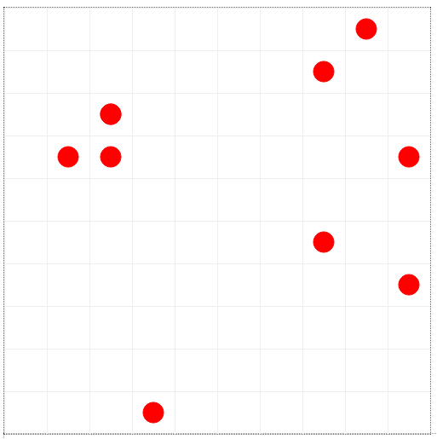
Simulation using Mesa / Python
10 agents (initially)
10 x 10 grid
agents can move in all directions, including diagonally
multiple agents can ocuppy a cell
all agents begin with a different piece of information: a random integer

Slide 5
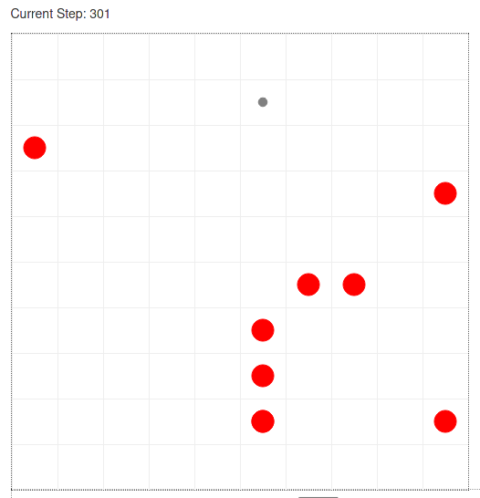
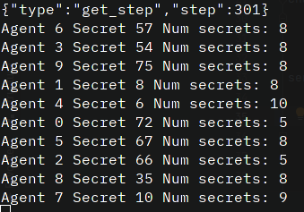

Gossip simulation
2 agents must be on the same cell in order to gossip
The agent network does not reach equilibrium after > 300 steps
Agent that has not yet synchronized with all of the agents
Agent that has synchronized with all of the other agents

Slide 6
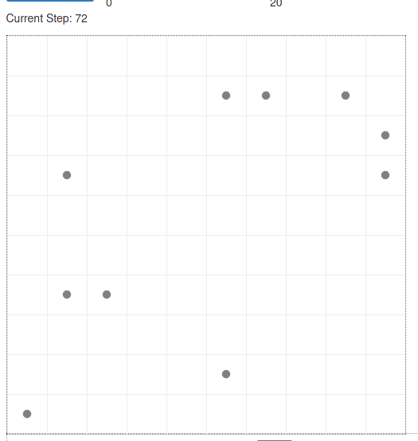
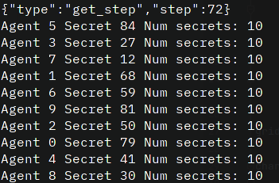
Stigmergy simulation
The agent network reaches equilibrium after < 100 steps
Tipically after 70-80 steps
Agent that has not yet synchronized with all of the agents
Agent that has synchronized with all of the other agents

Slide 7
Conclusion
If shared memory is possible (stigmergy) in a dense agent environment, shared memory will be much faster for spreading information than gossiping

Slide 8
Further possible improvements
Gossip model improvements
possibility to “talk” with agents on neighboring cells (1 or 2 level radius)
restrict to only one agent per cell
also gossip the information received from previous other agents -> potential for massive performance improvent
UI Improvements
Add input parameter controls
Better layout of web interface (make it more attractive)
Improve these slides

Slide 9
Thank you
Ionut Cotoi
Polytechnic University of Bucharest
Complex Systems Master Programme - 2020
Introduction in Complex Systems
icotoi@gmail.com
[1] Mesa Python - https://github.com/projectmesa/mesa
[2] This code - https://github.com/icotoi/cs-y1-isc1.git
[3] Gossip start - https://en.wikipedia.org/wiki/Gossip_protocol

